Slide 1
Clustering-A Overview
Thomas B. Kinsman

Slide 2
Data Normalization:
Makes different attributes commensurate:
Dynamic Ranging: A_{new} = (A_{old} – A_{min}) / (A_{max}-A_{min})
Zero Centering: A_{new} = 2 * (A_{old} – A_{min}) / (A_{max}-A_{min}) – 1
Z-Score: A_{new} = (A_{old} – A_{mean} ) / A_{standard_deviation}

Slide 3
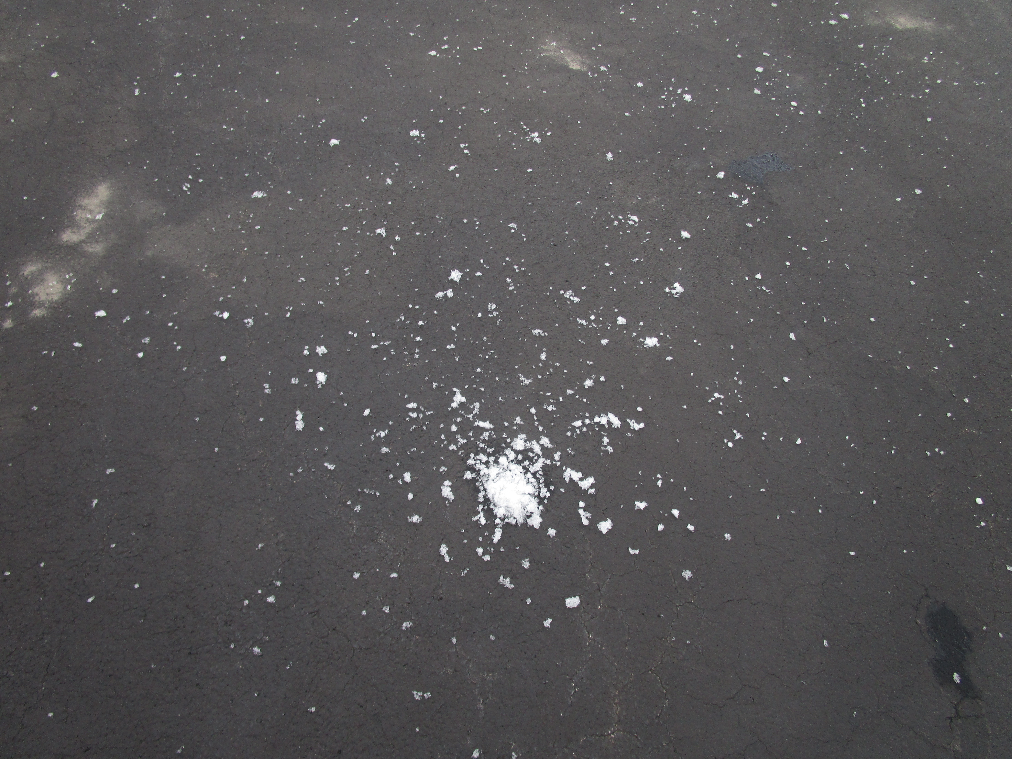
Notes:
“I threw a random variable.”

Slide 4


Slide 5
Motivation 1:
Object Segmentation: Objects in images can often be segmented using one attributes, such as color. The goal is to segment out the objects.

Slide 6
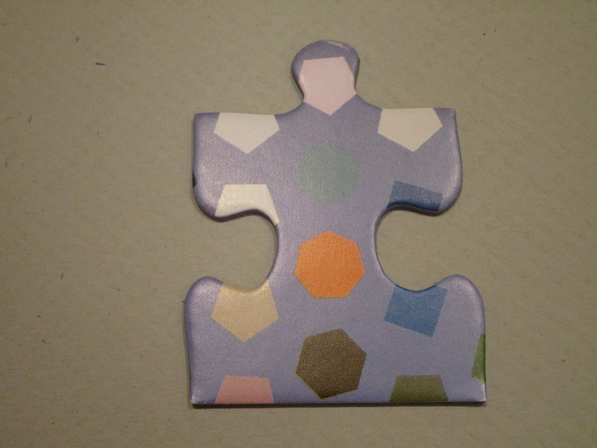
Motivation 2:
Background Removal: If you can form a cluster, or 8 clusters, which represent the background, you can ignore the background.

Slide 7

Motivation 3:
Attributes:
Think about other attributes – texture.
Chunks of image can be segmented based on many other attributes.
Here we will use position, and color.
But we could also use texture, or another attribute.
Example: The “camouflage” can be segmented from the brick by the difference in texture.

Slide 8
Motivation
Why Cluster? To understand the structure of your data. Remember – Data Mining is about Knowledge and Understanding.

Slide 9
An Example Taxonomy For Transistors
Why Cluster? To understand the structure of your data. Suppose I wanted to learn about electrical transistors. I can read about them, and then build my own clusters. By clustering based on the features which make sense to me, I map the information directly onto my past framework of understanding.
Example for types of transistors:
BJT Bi-Junction Transistors
FETS Field Effect Transistors

Slide 10
A Hierarchical Taxonomy For SOCKS
Dress Two Flavors: Designed to impress people ( or at least not offend them ).
Black – Go well in business situations
Argyle – Designed to impress others
Utility Designed to keep feet healthy Two Flavors:
White – Long, keep you feet warm, prevent sunburn Wash them all at the same time as your whites. Can be bleached to clean them.
Gray – Do pretty much the same thing, Wash them with all your other Gray clothes, or along with any other color. Who cares?!

Slide 11
An Example Taxonomy For Transistors
Example for types of transistors:
BJT Bi-Junction Transistors Two Flavors:
NPN – Electrons flow from emitter to collector
PNP – Conventional current flows from emitter to collector
FET Field Effect Transistors Two Flavors:
JFET – Junction Field Effect Transistor
MOSFET – Metal-Oxide-Semiconductor FET
Point 1: Clustering can make things easier to understand.
Point 2: A taxonomy is a hierarchy. Each cluster has sub-clusters.

Slide 12
Other Examples:
Why Cluster? To understand the structure of your data.
Tools:
kinds of hammers,
kinds of wrenches,
kinds of wood planes,
kinds of saws,
kinds of drill bits…
Business – types of customers
Medicine – types of illnesses
Information Retrieval – helps organize information

Slide 13
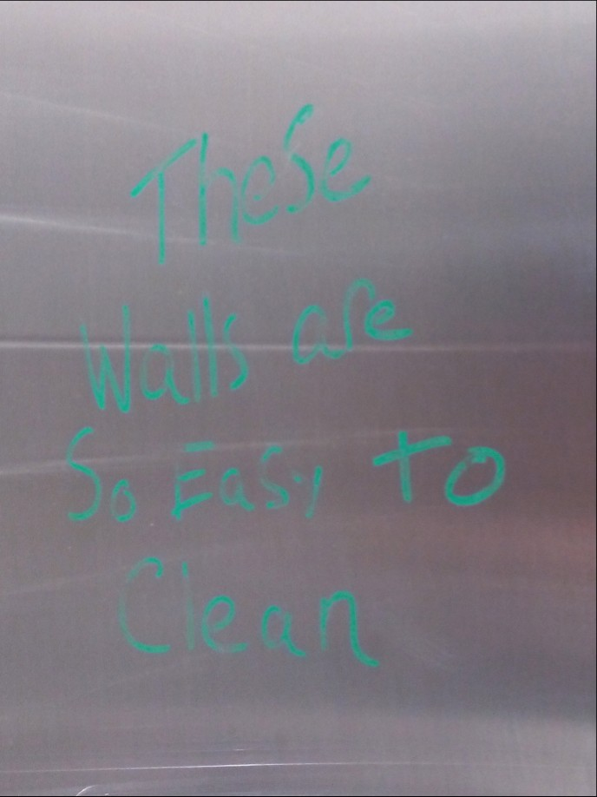
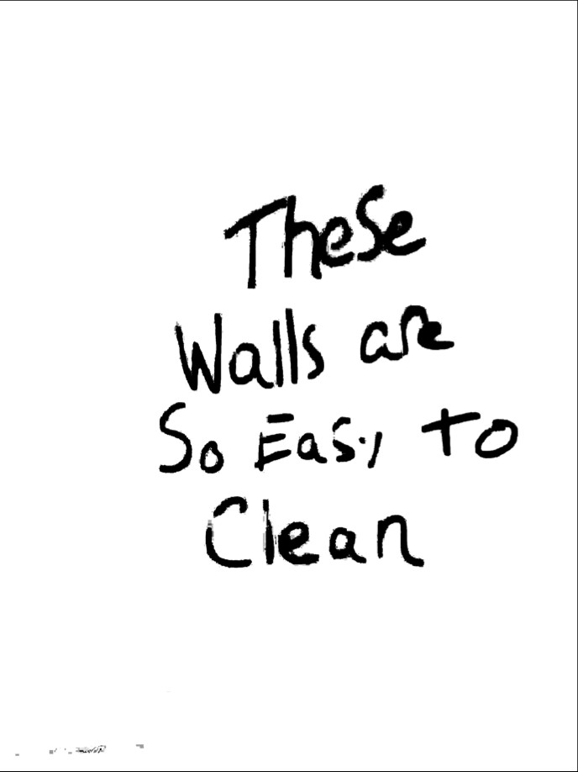
Graffiti – to Segment

Slide 14
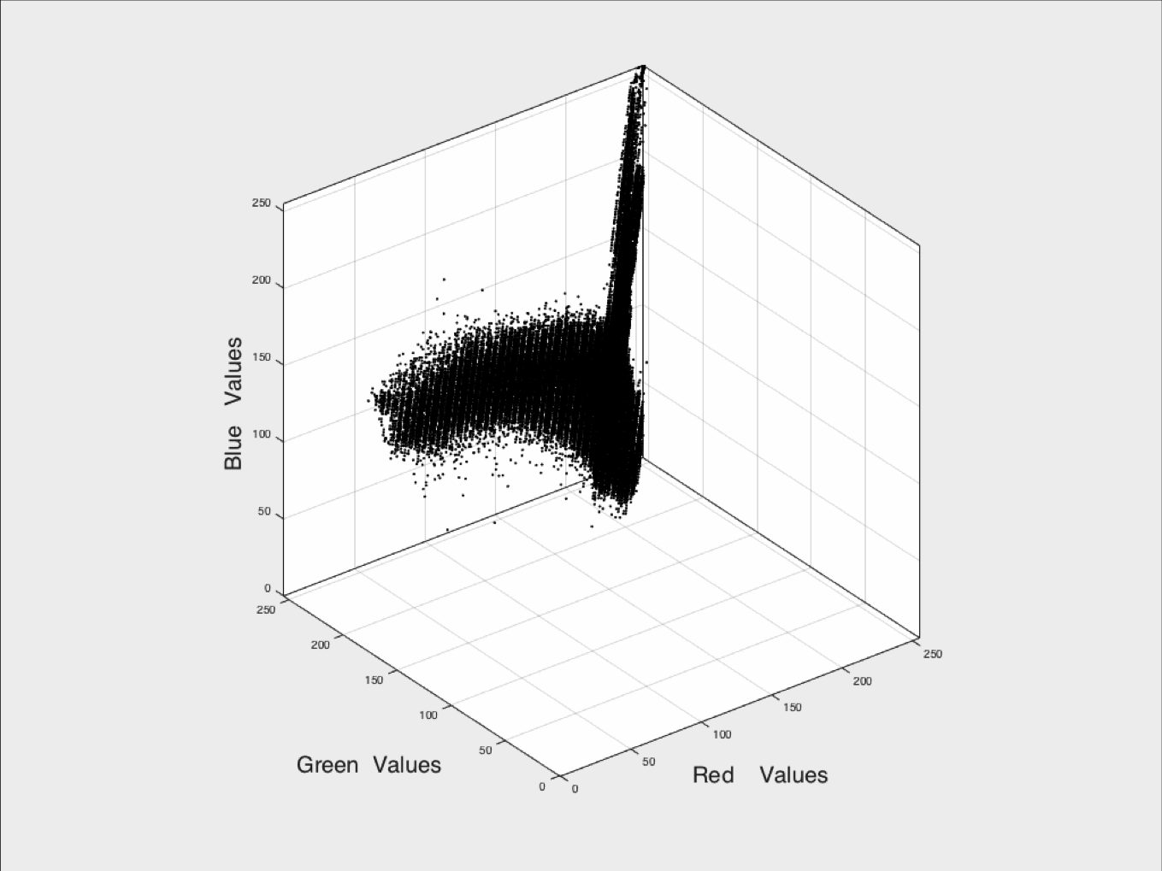
Graffiti – to Segment
There were two clusters found here.

Slide 15
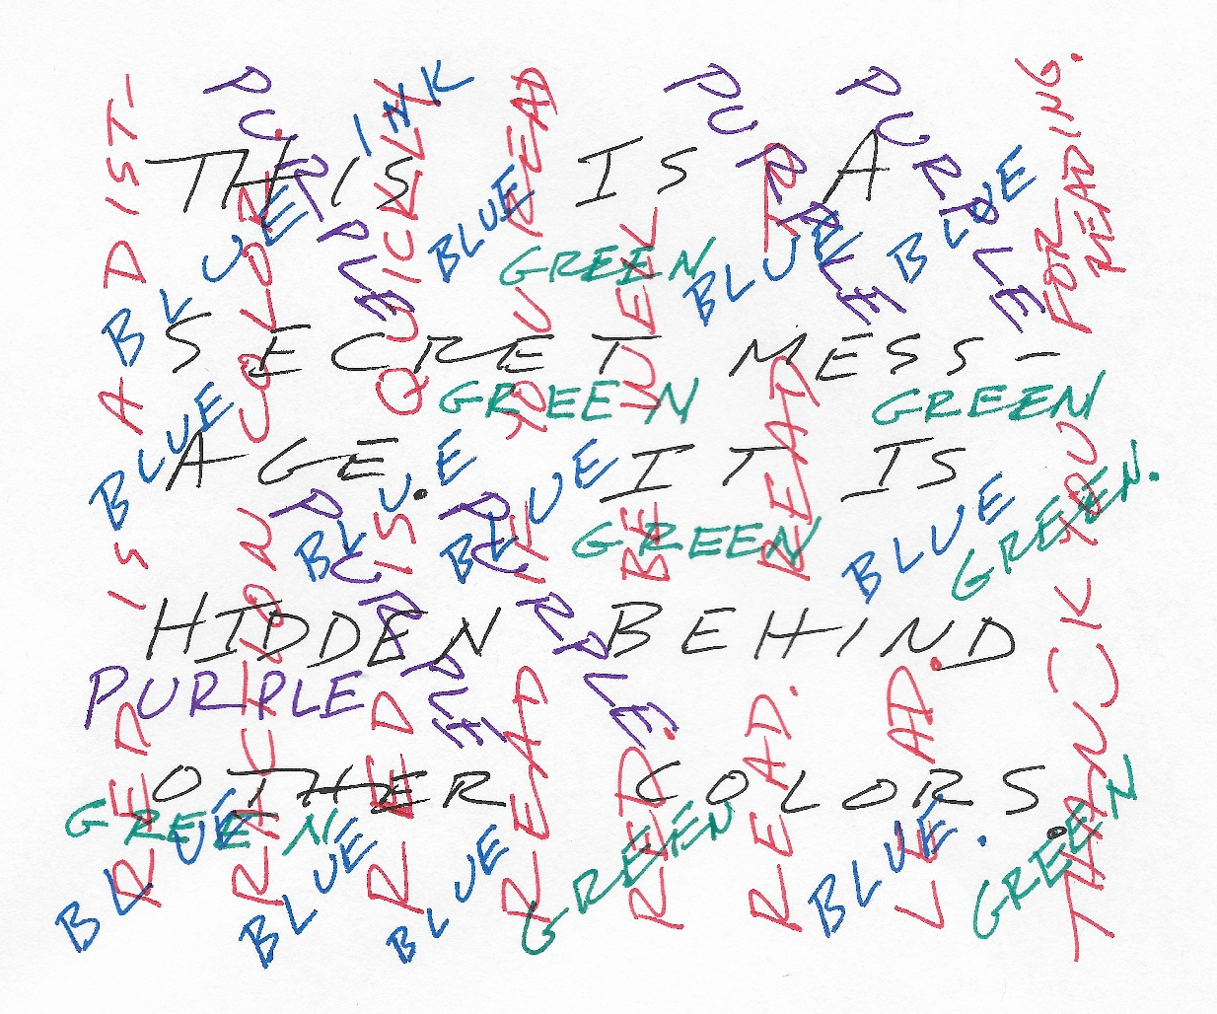
Secret Writing:

Slide 16
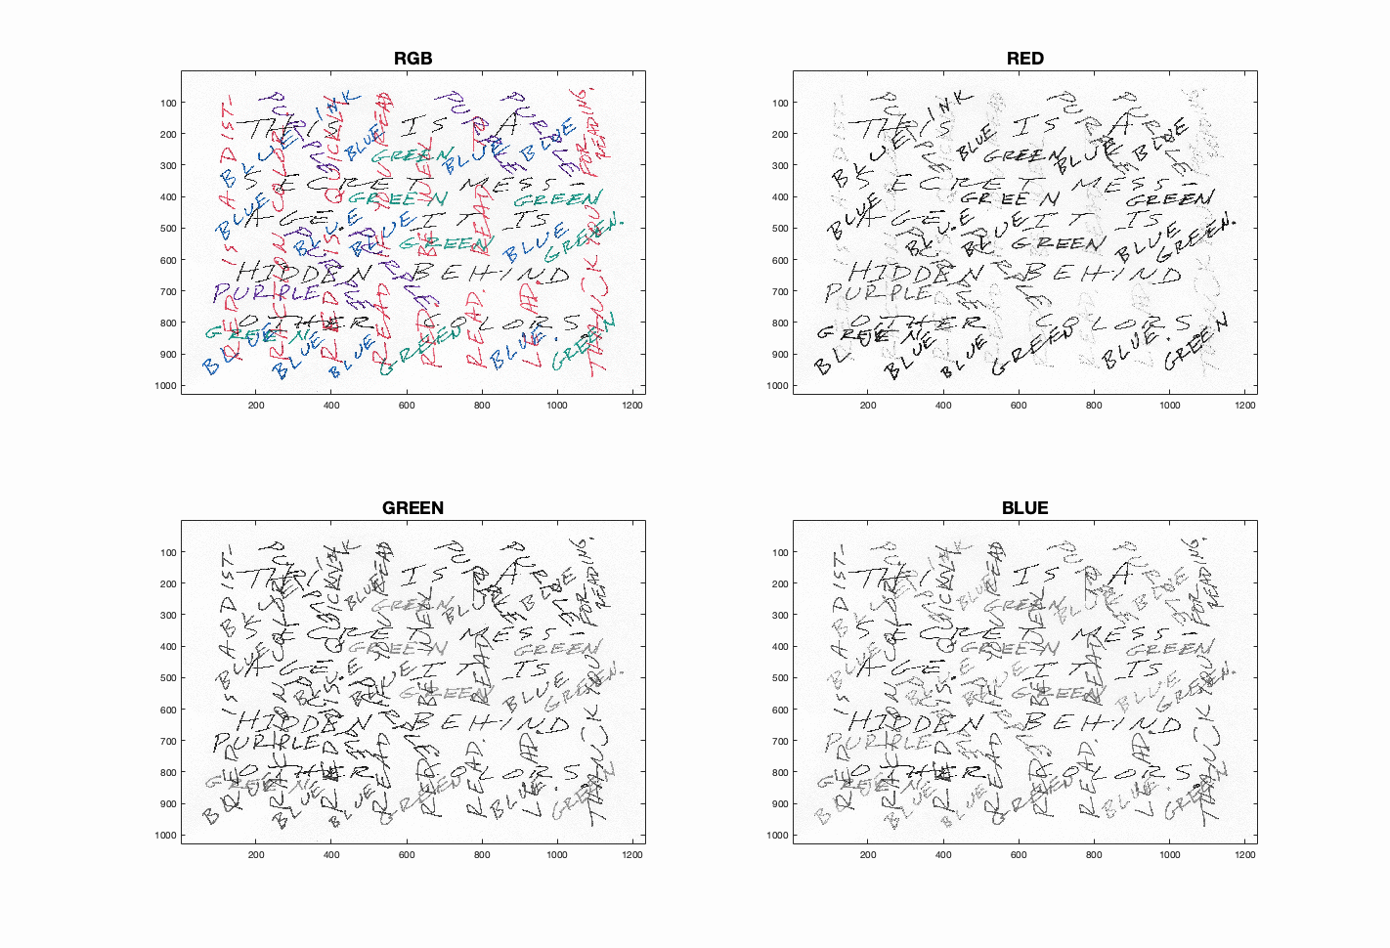
Secret Writing – RGB Separations:

Slide 17
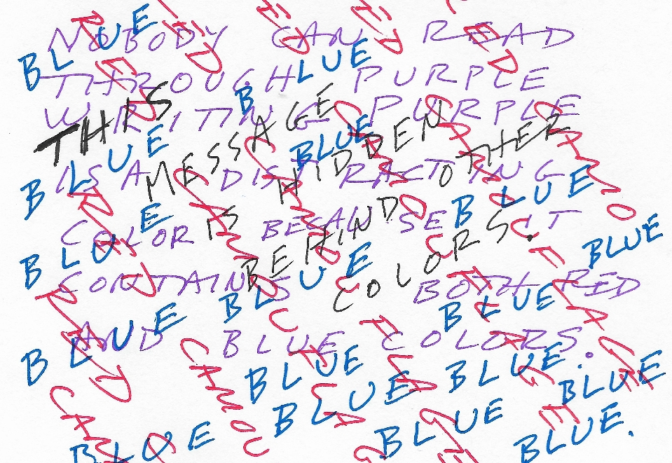
Input Image

Slide 18
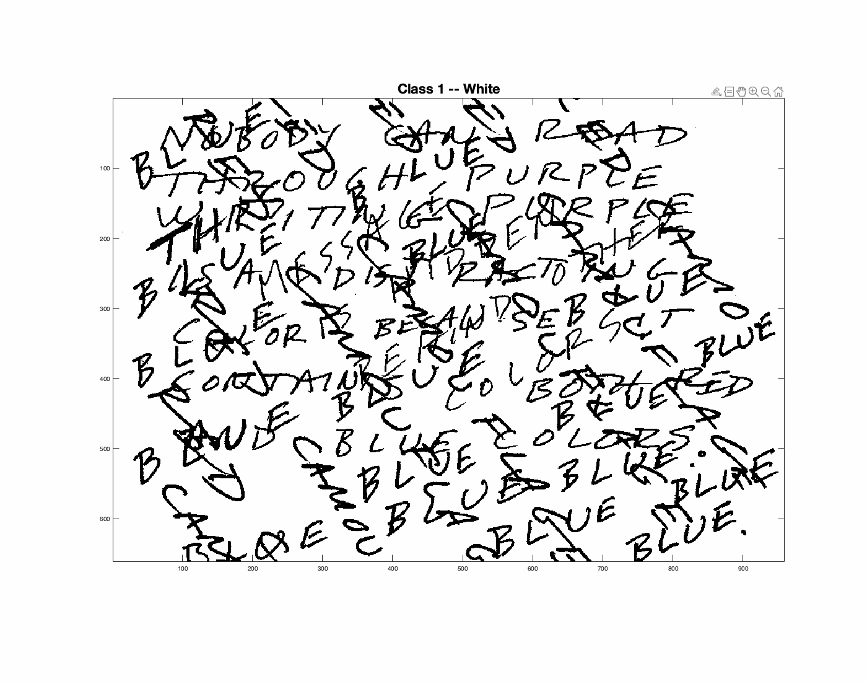
K-Means can separate the colors:

Slide 19
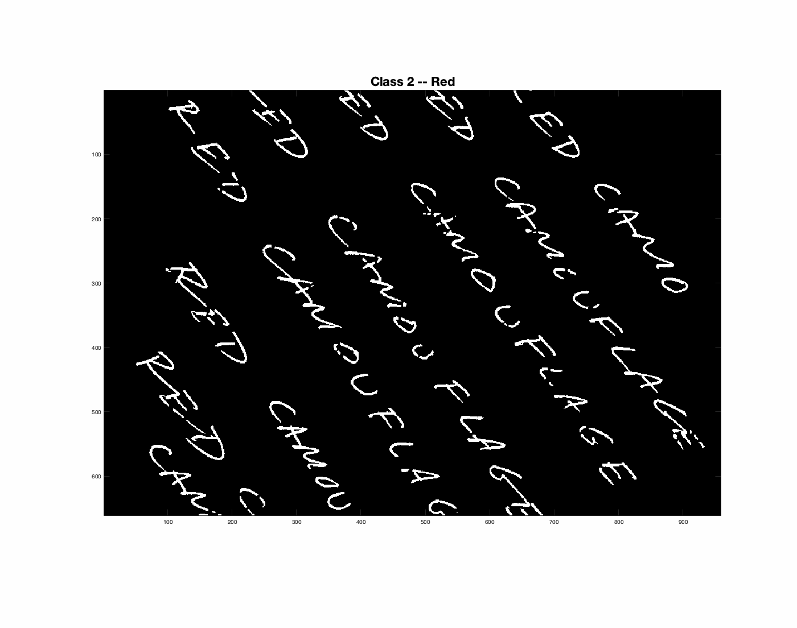
K-Means can separate the colors:

Slide 20
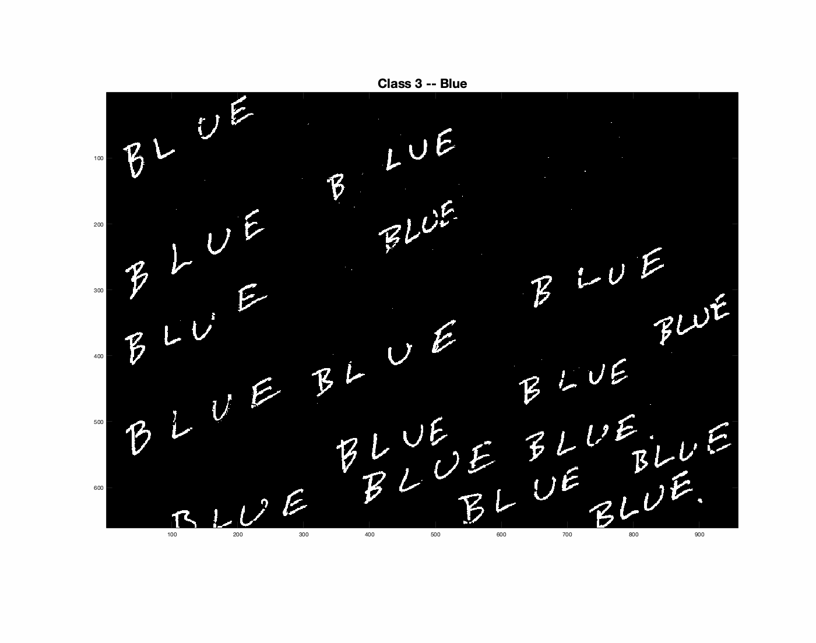
K-Means can separate the colors:

Slide 21
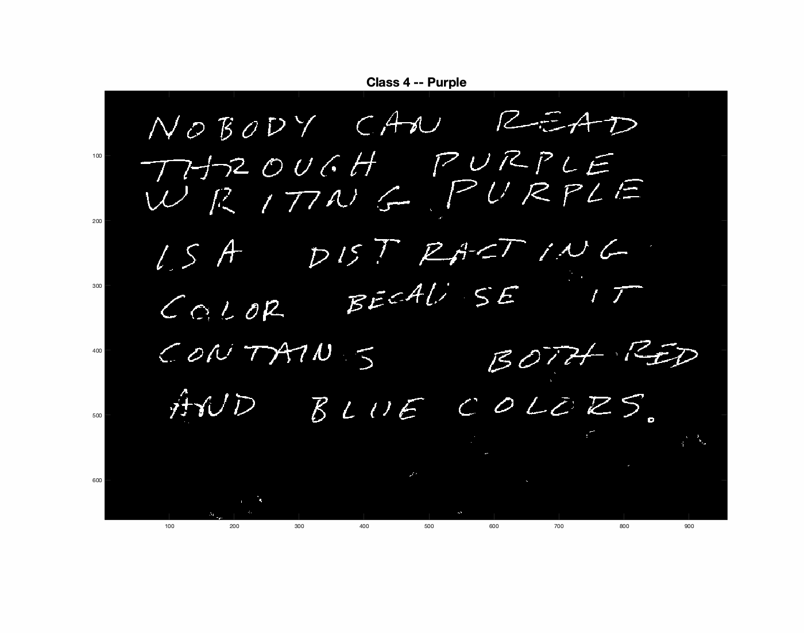
K-Means can separate the colors:

Slide 22
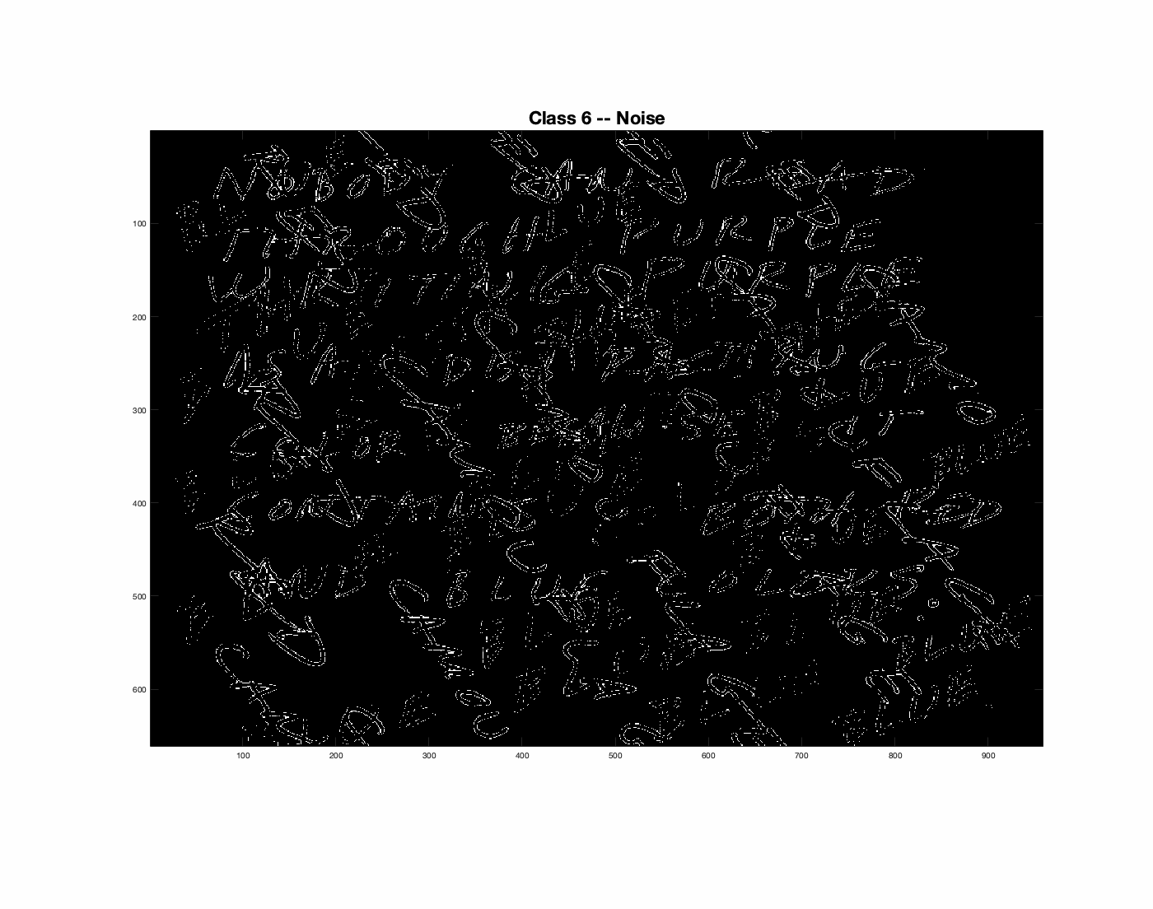
K-Means can separate the colors:

Slide 23
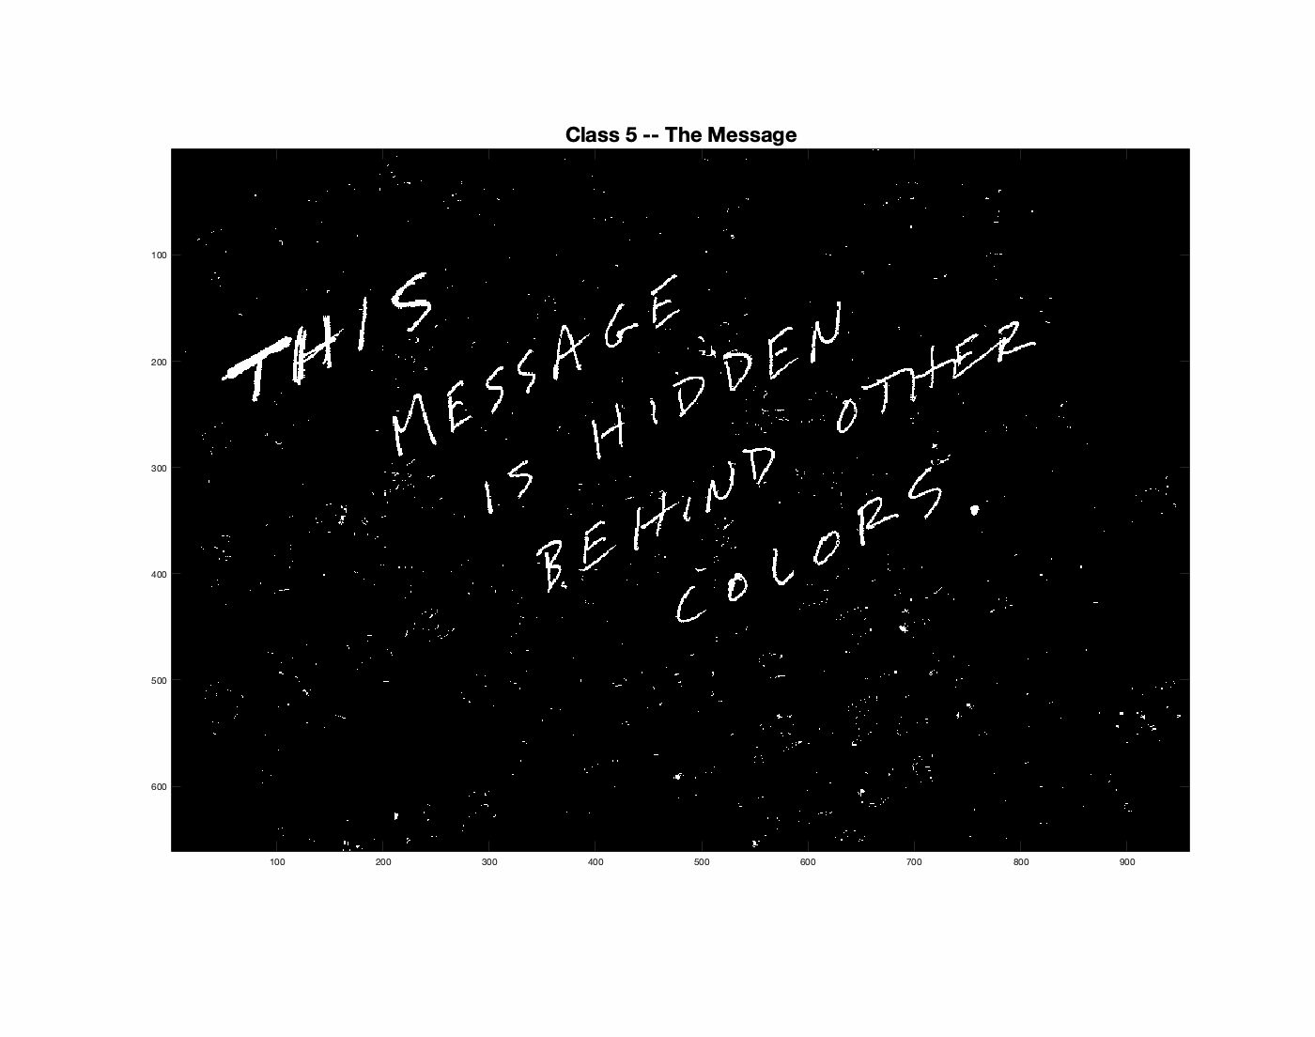
Realize Attributes are not always x and y

Slide 24
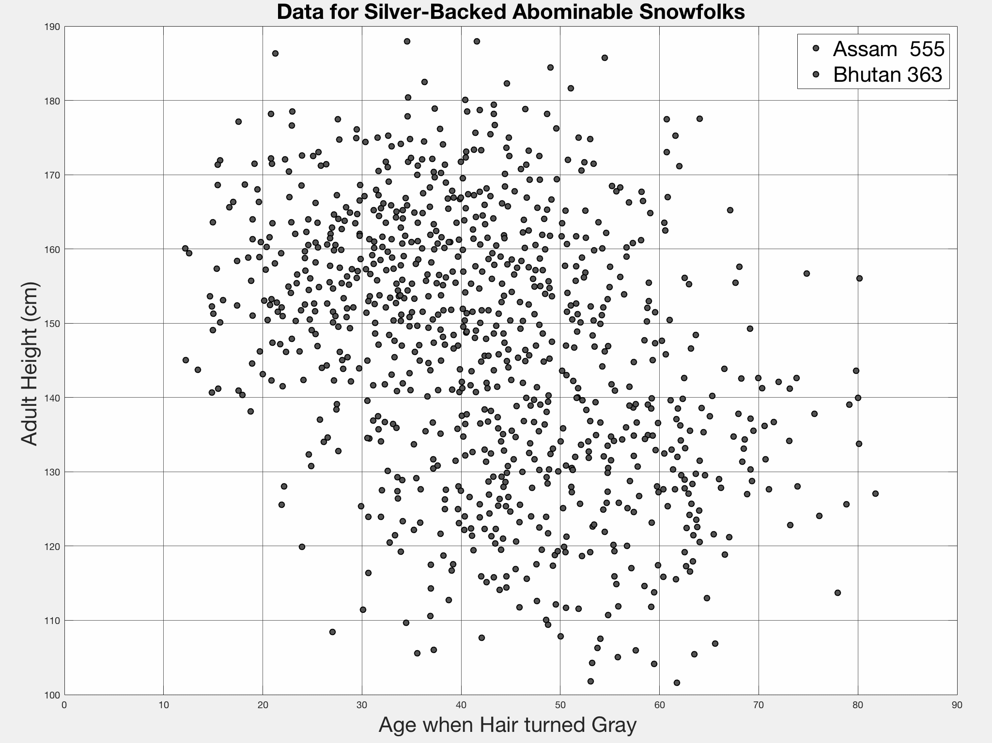
Note: Attributes are not always x and y

Slide 25
Measures of Central Tendency
Mean – the “average”
Mode – the most common value.
Median – the central value.
Centroid – the N-Dimensional center of mass. – the COM.
Medoid – the data point closest to the COM.

Slide 26
Review – Ideal Clustering
Finding groups of objects such that the objects in a group will be similar (or related) to one another, and different from (or unrelated to) the objects in other groups
Inter-cluster distances are maximized
Intra-cluster distances are minimized

Slide 27
The Number of Clusters is Ambiguous
How many clusters?
Six Clusters
Two Clusters
Four Clusters

Slide 28
The Three Main Approaches:
Top down: Divisive, starting with everything in one cluster, then sub-divide.
Bottom up Agglomerative, starting with many small clusters, then combine.
Random Guess and check, then fix.

Slide 29
The Main Algorithms:
Agglomerative-hierarchical ← bottom up Relational or related-ness clustering
K-Means ← guess and check Prototype-based clustering
Bisecting K-Means ← top down
DBScan Density based partitional clustering

Slide 30
Clustering Vocabulary
A clustering is a set of clusters.
This is confusing because “clustering” implies a process or action.
Better term might have been partitioning.

Slide 31
Hierarchical vs Partitional
Hierarchical vs Partitional clusters:
Hierarchical clustering:
A set of nested clusters organized as a hierarchical tree.
Agglomerative clustering is an example.
Partitional Clustering:
Division of data points into non-overlapping clusters such that each data point is in exactly one cluster.

Slide 32
Hierarchical Clustering
Traditional Hierarchical Clustering
Traditional Dendrogram
Non-traditional Hierarchical Clustering
Non-traditional Dendrogram

Slide 33
Partitional Clustering
The starting points
Resulting Partitional Clusters

Slide 34
Pseudo-Class, Stereotype, or Nickname
Informal term used to describe what you see.
Could be very simple:
Growing things
Dying things
Fashion conscious people
Techno- savvy people

Slide 35
Prototype – A Mathematical Prototype
Each cluster is associated with a prototype
A prototype is a mathematical model of the cluster’s:
center
extent
Common centers:
Centroid (center of mass)
Medoid (data point closest to center of mass)
Data point is assigned to the closest cluster
Number of clusters, K, must be specified

Slide 36
Attribute Choice is Extremely Important
The clusters get grouped by the chosen attributes
Type of proximity or density measure
This is a derived measure, but the epitome of importance
The relative distances between points is important
With the type of distance, impacts the shape of resulting clusters.
Sparseness
Dictates type of similarity
Adds to efficiency
Noise and Outliers
Outliers always throw off the center of mass

Slide 37
Review of Part A:
Clustering lets us discover the structure of our data.
If you can identify a “background cluster” it helps focus on things of true interest.
Clusters occur naturally, due to natural behaviors.
If we can arrange data into hierarchical taxonomies – clusters and sub-clusters, for better understanding.
The attributes you use for clustering determine the cluster shapes.
You want to normalize your attributes, so that they can be directly related to each other – so that the clusters are circular or spherical.
Main Approaches:
Top down
Bottom up
Hierarchical Traditional with one seed that grows
Hierarchical Non-Traditional, with multiple seeds.

